Slide 1
Advanced Sprint –Part 3
SSRS REPORT

Slide 2
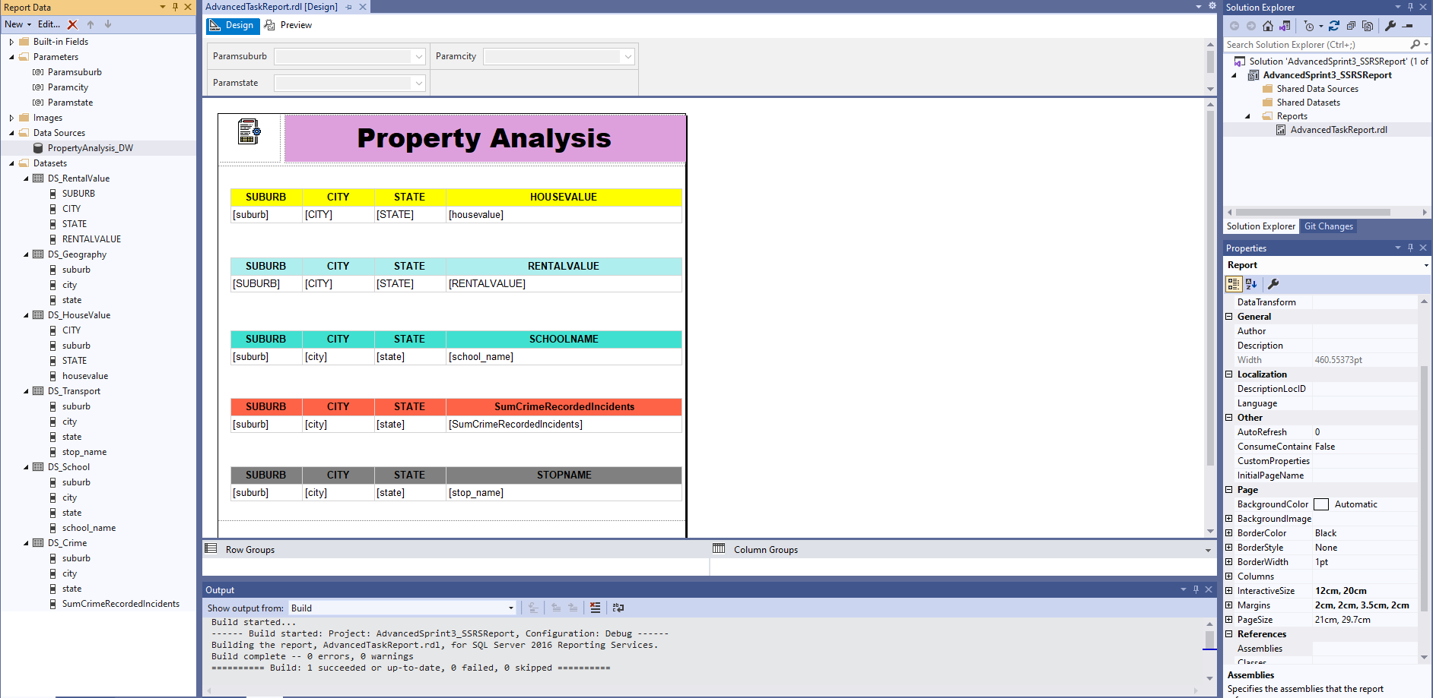
Use SSRS to connect to the Data Warehouse

Slide 3
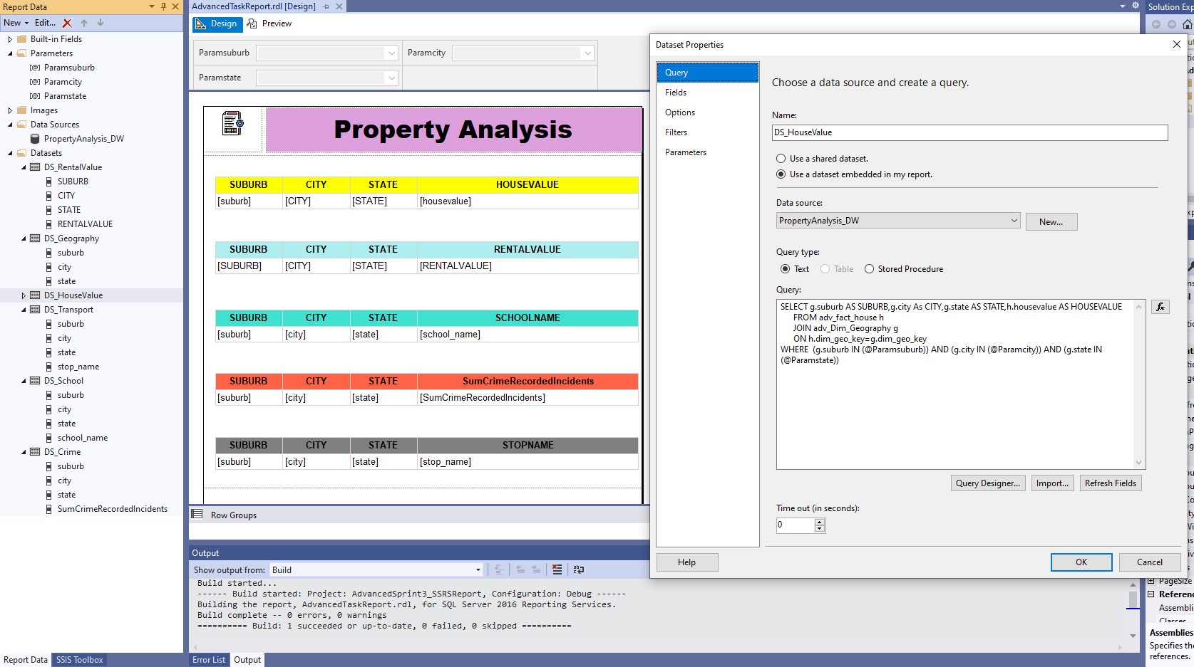
Write SQL Query or Stored Procedure to select data from the Data Model (Dimension and Fact tables).

Slide 4
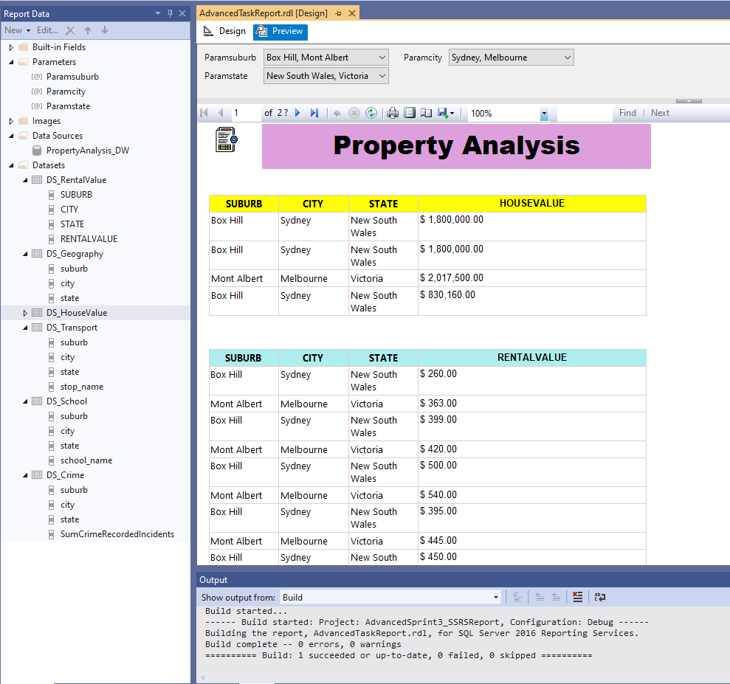
Design multiple SSRS table or matrix reports – Preview View for the report

Slide 5
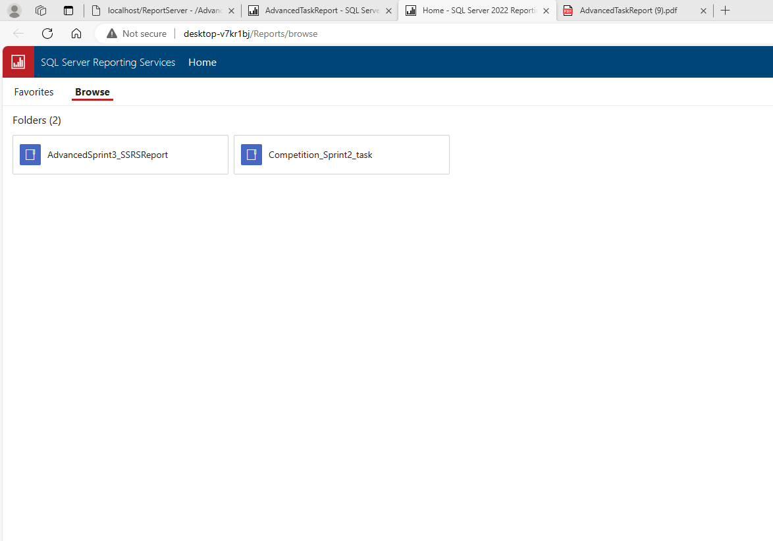
Published SSRS report into your web portal

Slide 6
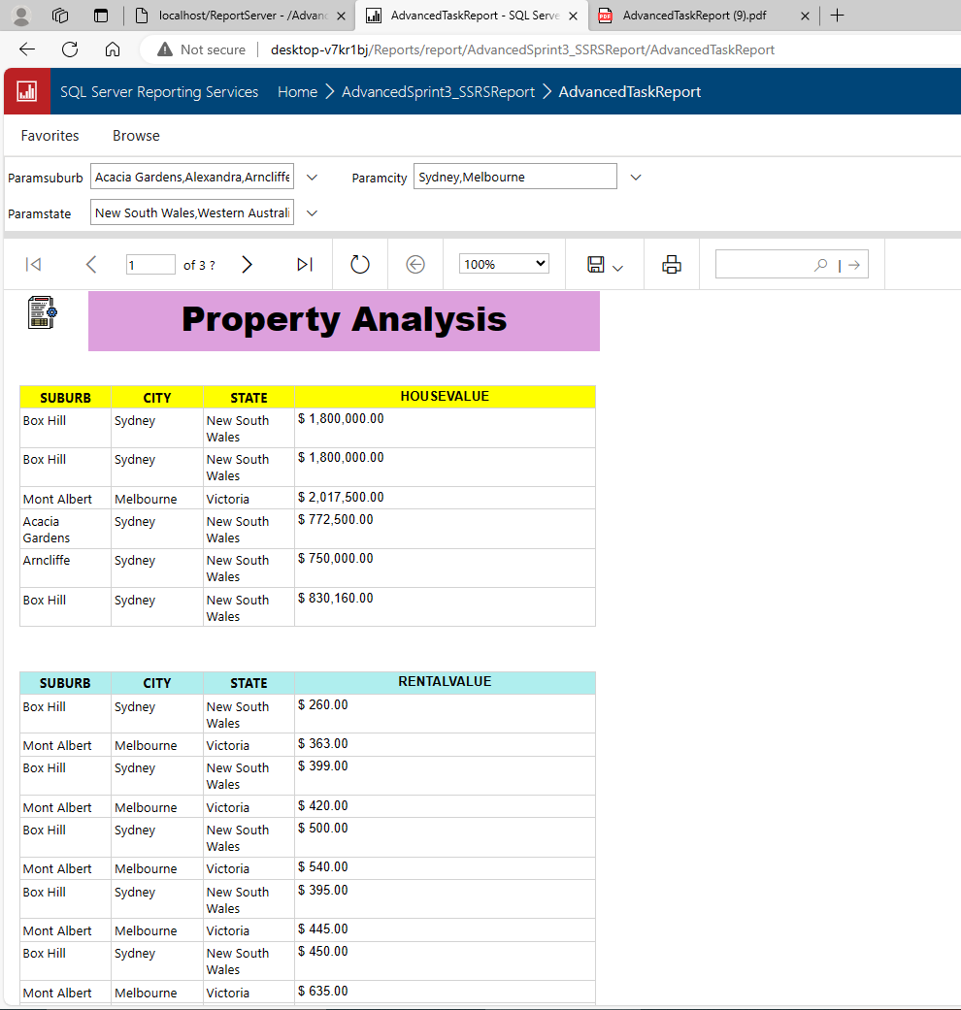
Report with given parameters on web portal

Slide 7
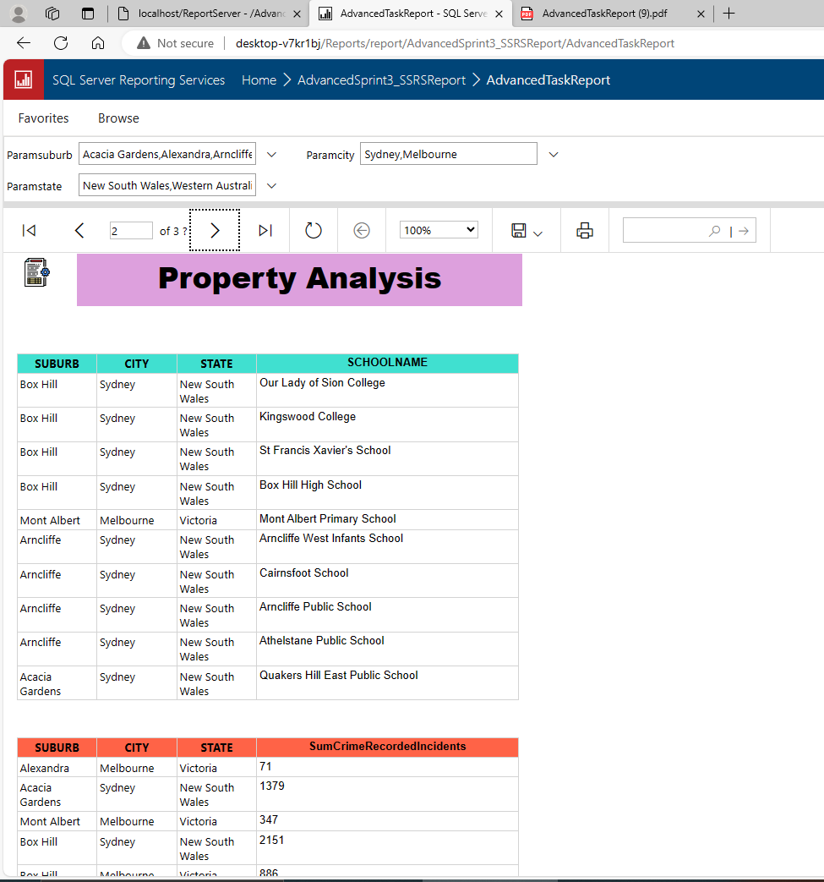
Report with given parameters on web portal

Slide 8
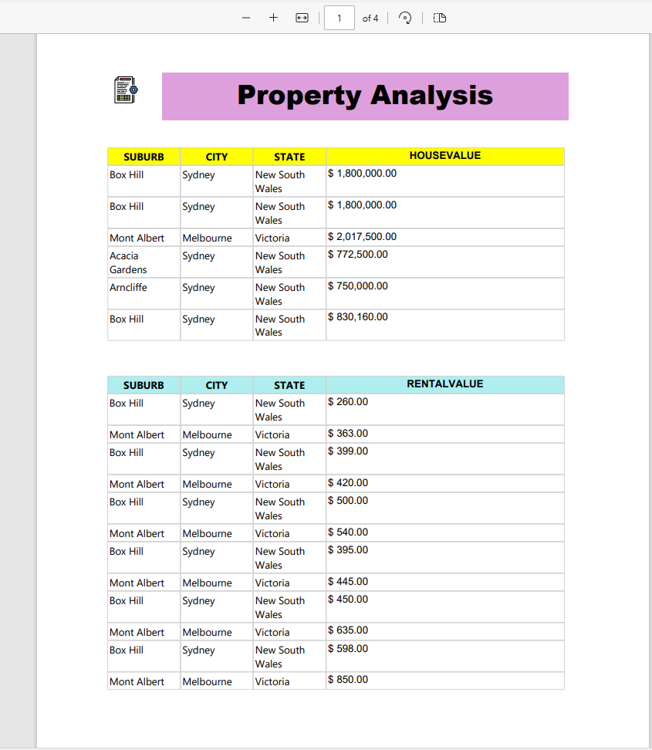
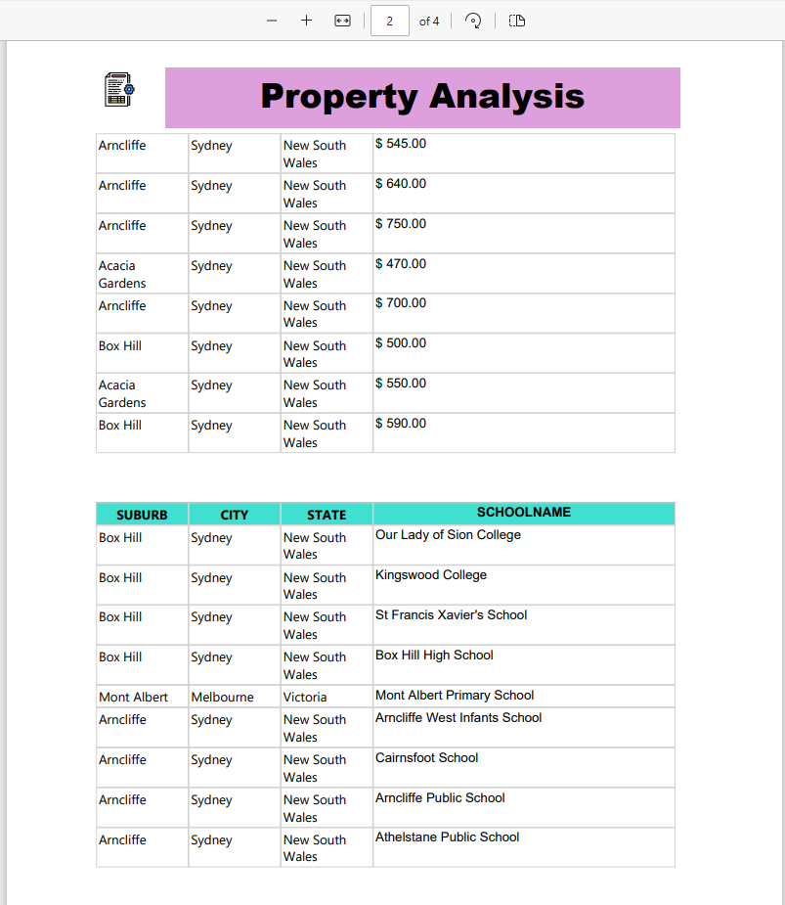
SSRS Report – PDF version

